Slide 1

Definition Disambiguation In The U.S. State Regulations
Dylan Walker, Chuntian Chi, & Haonan Peng
Notes:
Chuntian

Slide 2
Agenda
Introduction
US State Regulations
Previous Work and Background
What is Scoping?
Problem Overview
Task Breakdown
Definitions
Definition Insights
Terms with Multiple Definitions
Scope Identification and Disambiguation
Identifying Scoping Language
Handling Disambiguation
Notes:
Chuntian

Slide 3
Agenda (Continued)
XML Markup
Data Representation
Assigning Definitions
Future Work
Conclusions
Notes:
Chuntian

Slide 4
Introduction
Notes:
Chuntian

Slide 5
US State Regulations
The US State Regulations are the official legal regulations for each of the 50 states in the US.
Each individual regulation is developed by the legislative body of its respective state and acts as the official codification of laws that govern that state
Notes:
Chuntian

Slide 6

Cornell Legal Information Institute
The Legal Information Institute (LII) at Cornell University is an organization that publishes many legal corpora including the US State Regulations.
LII works to increase accessibility to legal information by developing systems to empower users from outside the legal profession to more easily access and understand the laws that govern them.
Notes:
Chuntian

Slide 7
Why is Definition Disambiguation Important?
A term is defined with different definitions across and within states.
State | Term | Definition
Florida | Equine | Any member of the family Equidae, including horses, mules, asses, and zebras.
North Carolina | Equine | Any member of the equine family, including horses, ponies, mules, asses and other equines;
Kansas (title 25) | Written notice | a written notification which is either hand-delivered, facsimile-transmitted or sent by certified mail.
Kansas (title 23) | Written notice | any paper or electronic document relevant to a matter that is filed with the Commission.
Notes:
Chuntian

Slide 8
Previous Works
Data
XML format
State regulations for all 50 states
Definition Extraction
CSV format
Where terms are defined
idnum | datapath | Tag | Method | Term | Definition
Agency 100 - Article 25 - section 1 | filepath | subsect | cues | Office | any place intended for the practice of the healing arts in the state of Kansas.
We want to know where they apply
Notes:
Chuntian

Slide 9
What is Scoping?
The scope of a definition denotes the segments of the corpus for which that definition is to be applied
Every defined term has an associated scope that designates that it’s usage within the regulation
These scopes vary in range from single parts or sections to entire titles
Title 1 - Division 1 - Chapter 1 - Article 1 - Section Cal-Code-Regs-Tit-1
The following definitions shall apply to the regulations contained in this chapter:
(1) "APA" means the part of the California Administrative Procedure Act appearing in California Government Code, Title 2, division 3, part 1, chapter 3.5, commencing with section 11340, which generally governs the adoption, amendment, or repeal of regulations by California state agencies.
Notes:
Chuntian

Slide 10
Goals
The end goal is to provide users with correct in-text annotations of term definitions within their context.
Our team’s goals are:
Develop methods to disambiguate definitions of a term
Associate a term with its correct definition in its context
Annotate term definitions in regulations

Slide 11
Problem Overview
Notes:
Dylan

Slide 12
Previous Work - Definition Extraction
Previous group of students developed a rule-based system to extract definitions from the US State Regulations
Same term defined with multiple definitions in different scopes
Different terms defined with similar definitions in different scopes
Notes:
Haonan

Slide 13
Previous work Usage
Well-defined scoping language
Used to generate insights of different corpora
Locate the context around the extracted definition
Notes:
Haonan

Slide 14
Task Breakdown
Gathering Statistics
Collect statistics on term frequency and diversity
Measure the frequency and diversity of scoping language
Compare and contrast statistics across state corpora
Scoping
Establish a baseline set of scoping phrases
Derive a system for identifying scoping language in XML
Disambiguate scoping language
XML Markup
Identify defined term instances in XML
Create a unique “definiendum” XML tag for definition markup
Create a unique identifier to reference each definition
Assign definitions to term instances using scope
Markup term instances in XML
Notes:
Dylan

Slide 15
Definitions
Notes:
Dylan

Slide 16
Definitions Overview
Definitions within legal corpora can be tricky and often differ from colloquial meanings
State | Classification of zebras
South Carolina | For the purpose of these regulations, "horse" means any member of the equine family including horses, mules, asses, zebras or other equadae.
Maryland | "Horse" means any member of the equine family, including horses, mules, asses, zebra, or other equidae.
Utah | Equine - means any animal in the family Equidae, including horses, asses, mules, ponies, and Zebras
Notes:
Haonan

Slide 17
Definition Insights
On average for each state corpus 31.99% of all terms are defined more than once
“Commissioner” defined 314 times in Connecticut - most of any defined term
“Department” is the most defined term in 21 states
154 times in New Mexico
132 times in Alaska
9 times in Missouri
Only 38.94% of all terms are accompanied by scoping language
Notes:
Dylan

Slide 18
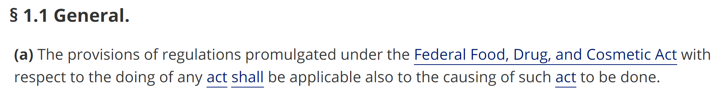
Terms with Multiple Definitions
Part-of-Speech (POS) Tag Exploration
Assume the POS tag of ambiguous words can clearly determine the correct sense
Facilitate the extraction of truly legally-defined occurrences of terms
Notes:
Haonan, Code of Federal Regulations. Can still make the point

Slide 19
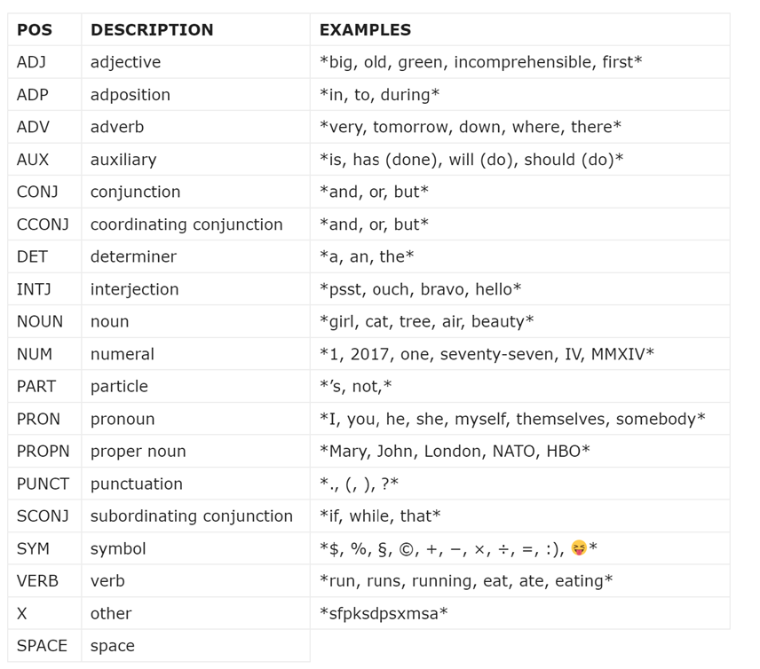
Terms with Multiple Definitions
POS tags for Spacy Library
Part-of-Speech (POS) Tag Exploration
Focused on two main POS tags for analysis
Three types of tags in the program:
Noun
Verb
Unk (Unknown)
Notes:
Haonan, Code of Federal Regulations. Can still make the point

Slide 20
Terms with Multiple Definitions
Word Vector Similarity Comparison
In-scope vs. Out-scope
Florida Corpus Chapter 68B-12
Notes:
Haonan, Code of Federal Regulations. Can still make the point

Slide 21
Terms with Multiple Definitions
Word Vector Similarity Comparison
In-scope vs. Out-scope
Extracted Definition of “kingfish”: Any fish of the species Scomberomorus cavalla.
Context of “kingfish” in Chapter 68B-12 : “King mackerel,” also commonly referred to as “kingfish,” means any fish of the species Scomberomorus cavalla.
Notes:
Haonan, Code of Federal Regulations. Can still make the point

Slide 22
Terms with Multiple Definitions
Word Vector Similarity Comparison
In-scope vs. Out-scope
Context of “kingfish” in Chapter 68B-12 : “King mackerel,” also commonly referred to as “kingfish,” means any fish of the species Scomberomorus cavalla.
Program Disambiguated Sense of “kingfish”
Notes:
Haonan, Code of Federal Regulations. Can still make the point

Slide 23
Terms with Multiple Definitions
Word Vector Similarity Comparison
In-scope vs. Out-scope
Similarity Comparison using Word Vector
Extracted Definition
Program Disambiguated Sense of term “kingfish”
Notes:
Haonan, Code of Federal Regulations. Can still make the point

Slide 24
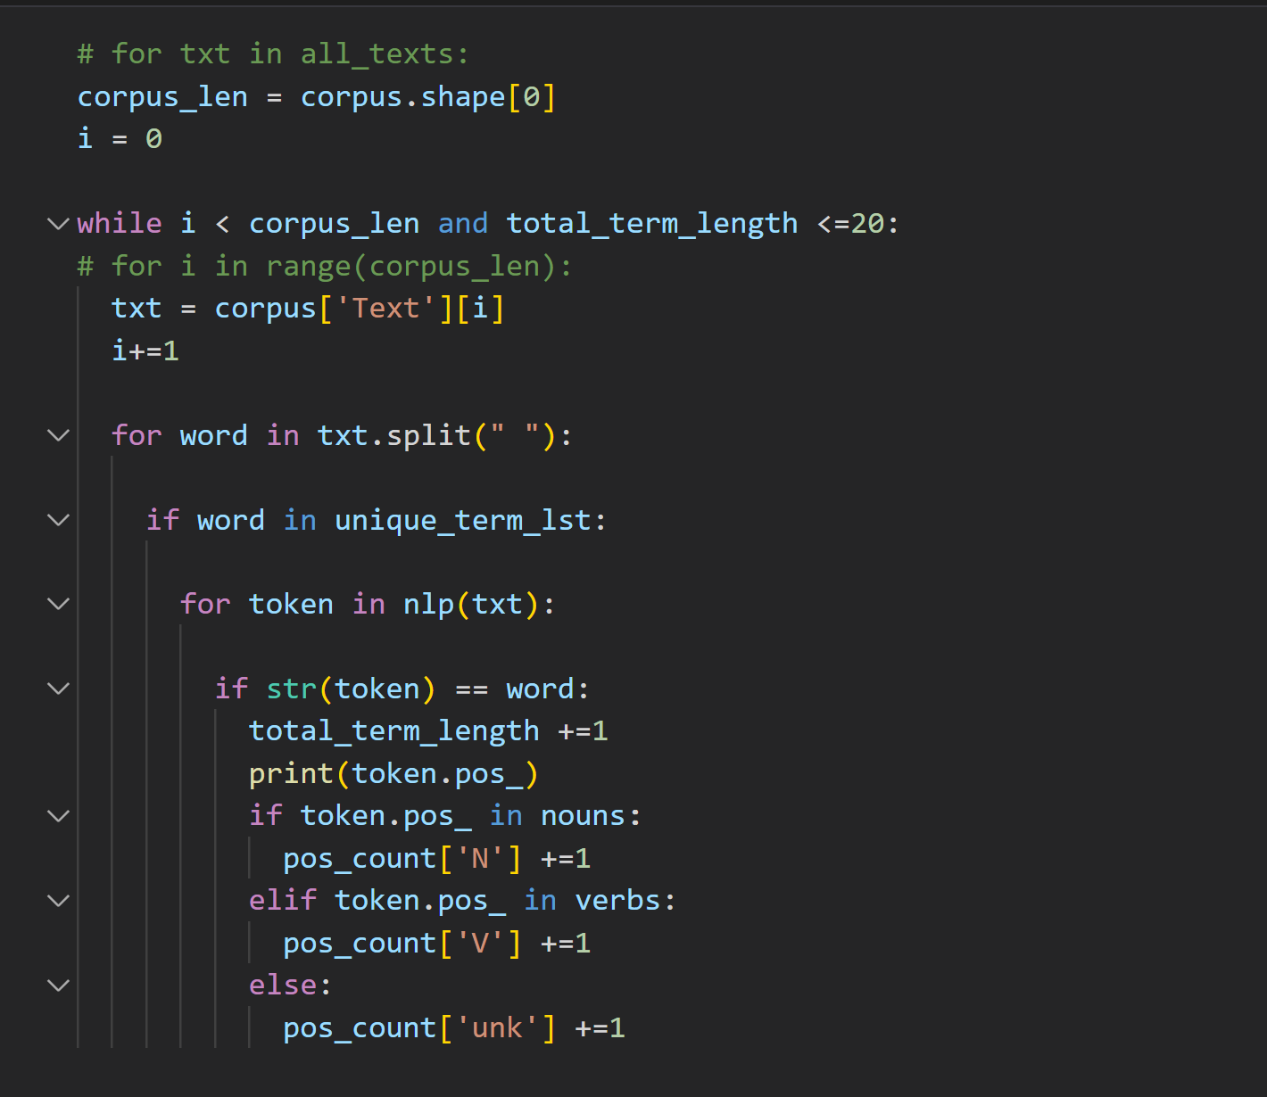
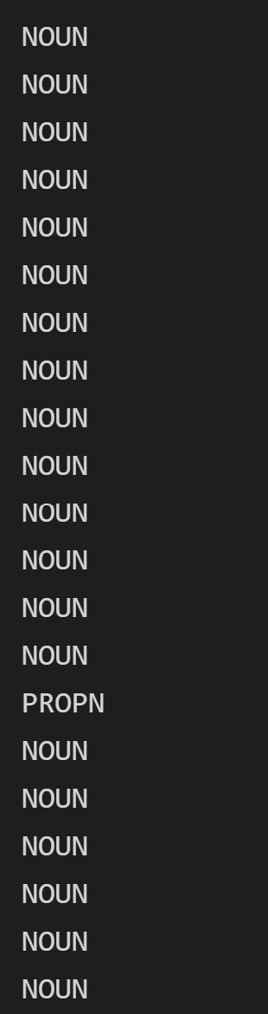
Part-of-Speech (POS) Tag Exploration
Use Part-of-Speech tag of the defined terms to find the right scope
Notes:
Haonan

Slide 25
Word Vector Similarity Comparison
Use disambiguated context of a defined term to compare with extracted definitions
For example, if term A is defined in article 15, a disambiguated definition will first be generated for that term using its context. Then, the proper definition of that term will be extracted from article 15. To contrast with the In-Scope definition of term A, another definition of term A will be extracted from an article that is not article 15.
Total Noun POS (Part-of-Speech) occurrences account for 52.5% of all defined term occurrences.
Total Verb POS (Part-of-Speech) occurrences account for only 2.8% of all defined term occurrences.
Notes:
Haonan

Slide 26
Challenge - To define or not to define
POS tags are mostly Noun tag or Unk (unknown) tag
Total Noun tag occurrences account for 52.5% of all defined term occurrences.
Total Verb tag occurrences account for only 2.8% of all defined term occurrences.
Total Unk (unknown) tag occurrences account for 44.7% of all defined term occurrences.
In-scope and Out-scope similarity are close
Average In-scope Similarity is about 73.9%
Average Out-scope Similarity is about 73.5%
Notes:
Haonan

Slide 27
Scope Identification and Disambiguation
Notes:
Dylan

Slide 28
Predefined Scoping Phrases
Wide variety of corpus hierarchy and scoping language across states
Calls for a predefined list of generalizable scoping phrases
Collected a list of ~20 template phrases through exploration
Example Scoping Phrases
When used in
As used in this
Under the provisions of this
For purposes of this
Within the scope of this
For purposes of the application under this
As defined in
As specified in
Notes:
Dylan

Slide 29
Identifying Scoping Language
Extract definitions from each State Regulation
Use extracted definitions to identify all files containing definitions
Search each definition file for predefined scoping phrases to identify scoping sentences
Search scoping sentences for scope keywords (Ex. “Chapter”, “Title”, etc)
Notes:
Dylan

Slide 30
Ambiguous Scopes
A piece of scoping language is well-defined if the range of the scope is clearly stated and easily interpretable.
A piece of scoping language is ambiguous if the range of the scope is not easily interpretable and requires additional context and information than the scoping language itself.
“As used in this section: ‘Commissioner’ means the Commissioner of Motor Vehicles or his authorized representative.” - Connecticut, Title 1 Section 1H-8
“As used in these rules: ‘Department’ means the Michigan department of health and human services.” - Michigan, Licensing and Regulatory Affairs
Notes:
Dylan

Slide 31
Handling Scopes
Well defined scoping language can be easily resolved by keyword detection
Ambiguous scoping language must be resolved to a default scope
Definitions absent of any scoping language also assigned a default scope
Location | Scoping Phrase | Scope
Title 1 - Chapter 7 - Section 3 | “For purposes of this chapter” | Title 1 - Chapter 7
Title 2 - Division 1 - Article 4 | “As used in these rules” | Title 2 - Division 1 - Article 4
Title 3 - Part 1 - Subpart C | No scoping language detected | Title 3 - Part 1 - Subpart C
Notes:
Dylan

Slide 32
XML Markup
Notes:
Haonan

Slide 33
Markup Overview
Goals
Find all defined term instances in a given state regulation
Modify XML documents to indicate defined terms
Include unambiguous references to corresponding definitions
Standards
All Markup definitions should use the “definiendum” tag
XML structure should be maintained for all non-definition elements
Spacing and content should be consistent between original and markup documents
Notes:
Haonan

Slide 34
The Definiendum Tag
During the markup process we need a unique tag that denotes our defined terms and any necessary information for linking them with their associated definitions. To do this we create the special “definiendum” tag. This tag includes three main attributes:
ID - unique identifier of the corresponding definition
numOccur - Which number occurrence of the definition the current instance is
Markup = “no” - Denotes a definition was matched using a default scope.
<designator>(e) </designator> “<definiendum id=“3498147938864613123” numOccur=“1” markup=“no”>Residential Program</definiendum>” means a duly licensed, certified or approved foster family boarding home, agency boarding home,
supervised independent living program, group home, group residence, or any combination thereof as such terms are defined under 18 NYCRR section.
Notes:
Dylan

Slide 35
Representing Defined Terms
A defined term describe a unique definition within a given state corpus.
Let’s look at an example defined term from Florida
Attribute | Value
Term | Pompano
Definition | “any fish of the species Trachinotus carolinus, or any part thereof.”
Definition ID | 8008162398517937498
Scope | Department 68 - Division 68B - Chapter 68B-35
Number of Occurrences | 7
Notes:
Dylan

Slide 36
Representing Term Instances
A term instance is a unique appearance within the text of a given defined term.
These are the exact elements we are looking to markup! Here’s an example from the Ohio corpus
Attribute | Value
Term | honey
Definition | “the nectar and saccharine exudation of plants that has been gathered, modified, and stored in a honeycomb by honeybees.”
Definition ID | 3679109684013952724
Instance Number | 3
Notes:
Dylan

Slide 37
Identifying Term Instances
Apply definition extraction and scope assignment to all defined terms
Combine all defined terms into a dictionary structure
Keys correspond to unique term strings
Values are lists of DefinedTerm objects for each possible definition of the term
Cross-compare XML document text with defined terms using modified string matching
Example Dictionary Key | Example Dictionary Value
Applicant | Definition: A person seeking certification as an officer. Scope: Agency 106 - Article 2 Definition: A landowner or legal agent applying for financial assistance to construct or apply conservation or pollution control practices. Scope: Agency 11 - Article 1
Notes:
Chuntian

Slide 38
Assigning Definitions
Identify all terms that have a definition that is in-scope for this document
Document: Agency 28 - Article 50
Example Dictionary Key | Example Dictionary Value
Applicant | Definition: A person seeking certification as an officer. Scope: Agency 106 - Article 2 Definition: A landowner or legal agent applying for financial assistance to construct or apply conservation or pollution control practices. Scope: Agency 11 - Article 1
Applicator | Definition: a structure that determines the extent of the treatment field at a given distance from the virtual source. Scope: Agency 28

Slide 39
Assigning Definitions
Identify all terms that have a definition that is in-scope for this document
For each element of the document: search for matches between the element text and the in-scope definitions
For each match assign definition based on matching scope
Markup each match with “definiendum” tag
XML Text
Document IDnum
In-Scope Definitions
Term Instances
XML Markup
Definition Dictionary
Notes:
Chuntian

Slide 40
Markup Challenges
Notes:
Chuntian

Slide 41
Challenges - Lemmatization
Lemmatization: the grouping together of different forms of the same word.
Lemmatized term
List of tokenized words from text
List of lemmatized tokens
List of positions of words in original text (0-index based)
Example:
Term: facility
Tokens: ['fire', 'protection', 'and', 'public', 'safety', 'facilities', ';']
Lemmatized: ['fire', 'protection', 'and', 'public', 'safety', 'facility', ';']
Position: [[(1, 5)], [(10, 20)], [(21, 24)], [(25, 31)], [(32, 38)], [(39, 49)], [(49, 50)]]
Notes:
Chuntian

Slide 42
Challenges - Subtoken Definitions
Naive string matching creates problems with subtoken definitions
First approach was to add spacing to either side of a term during search
Fails to resolve punctuation and sentence/element boundaries
Solved issue by checking if boundary contained alphanumeric characters
<designator> (A) </designator> During the 18-month period immediately p<definiendum id=“3510363150165908518” numOccur=“1”>rec</definiendum>eding the license expiration date, the <definiendum id=“0346167350003974478” numOccur=“1”>person</definiendum> completed at least 50 credits
Notes:
Dylan

Slide 43
Challenges - Nested Definitions
Nested instances occur when a defined term appears as a word of phrase within the use of another defined term
Introduces complications to both identification/definition assignment as well as markup
Defined Term | Definition
Attendant | a staff person or volunteer who provides direct supervision of a juvenile.
Attendant Care | one-on-one direct supervision of a juvenile who has been taken into custody. Attendant care shall not exceed 24 hours exclusive of weekends and court holidays.
Attendant Care Facility | a boarding home for children at which attendant care is provided.
Notes:
Dylan

Slide 44
Challenges - Nested Definitions
Only the outermost defined term of a nested instance shall be marked up
Sorted defined terms from longest to shortest to ensure outermost terms are processed first
Prevent searching from within already tagged “definiendum” elements
"<definiendum id="3458623777646826528" numOccur="1" markup="no">Attendant care</definiendum>" means one-on-one direct supervision of a juvenile who has been taken into custody.
Notes:
Dylan

Slide 45
Future Work

Slide 46
Future Work
More sophisticated scope extraction
Potentially use machine learning techniques to improve scoping
Handle ambiguous scopes - derive rules from domain expert
Improve definition assignment to include more than scope
Improve efficiency of definition extraction and assignment
Notes:
Dylan

Slide 47
Conclusions

Slide 48
Conclusions
Collected insightful statistics on defined terms in the US State Regulations
Applied a variety of methods to identify and disambiguate scoping language
Developed a system to assign definitions to term instances
Marked up all the defined terms in the xml file
Terms with a well-defined scoping language
Terms with an ambiguous scoping langage
Terms without any scoping language
Notes:
Haonan

Slide 49
Thank You!

